Slide 1
The Digital Divide: Protecting Our Elders from Cyber Fraud
Hujambo. My name is Evans Mwaura Mburu, a final-year Computer Science student at Dedan Kimathi University of Technology. Growing up in Ruiru and spending time in the rural parts of Kiambu, I have witnessed a revolution. The mobile phone has transformed how our grandparents live. It allows them to receive money from children in the city, pay for fertilizer, and save for the future.
But with this convenience comes a dark shadow. Let me tell you a story about a woman we will call 'Cucu Wanjiku.' She lives in a village not far from where I grew up. She is 74 years old. One afternoon, she received a call. A calm, authoritative voice told her that her SIM card was about to be locked due to a government regulation. Panic set in. The voice guided her, in her own language, to 'fix' the issue. In her confusion and fear, she unknowingly transferred her entire pension savings to a stranger.
This is not just a story. It is a reality for thousands of elderly Kenyans. Today, I am presenting on the challenge of Cybersecurity Threats Targeting the Elderly in Rural Kenya and proposing a dual solution: one technical, and one social.

Slide 2

Abstract: Cybersecurity for Elderly Kenyans
English Abstract
Kiswahili Abstract
Kikuyu Abstract
This presentation addresses the escalating cybersecurity threats faced by elderly individuals in rural Kenya, primarily due to their late adoption of mobile technology and susceptibility to social engineering tactics. It highlights the devastating impact of these scams, which exploit trust, fear, and cultural respect. A dual solution is proposed: a technical approach involving AI-driven anomaly detection and voice biometrics for mobile money transactions, and a social approach centered on community-based 'Digital Barazas' and youth mentorship programs to foster cyber hygiene education in indigenous languages.
Mada hii inazungumzia ongezeko la vitisho vya usalama wa mtandaoni vinavyowakabili wazee vijijini Kenya, hasa kutokana na kuchelewa kwao kutumia teknolojia ya simu na udhaifu wao kwa mbinu za uhandisi wa kijamii. Inaangazia athari mbaya za ulaghai huu, ambao unatumia imani, hofu, na heshima za kitamaduni. Suluhisho la pande mbili linapendekezwa: mbinu ya kiufundi inayohusisha utambuzi wa hitilafu unaoendeshwa na AI na biometriska ya sauti kwa miamala ya pesa za simu, na mbinu ya kijamii inayozingatia 'Baraza za Kidijitali' za jamii na programu za ushauri wa vijana kukuza elimu ya usalama wa mtandaoni kwa lugha za kiasili.
Mĩhaka ĩno ĩkũgweta ũrĩa kũrĩ na ũndũ wa kũingĩha kwa kũhĩngĩcwo kwa arũme na atumia akũrũ bũrũri-inĩ wa Kenya, makĩhĩngĩcwo nĩ ũndũ wa kũhĩtĩrĩra gũthoma ũhoro wa thimũ na kũhĩngĩcwo nĩ ũndũ wa kũhĩtĩrĩra ũhoro wa thimũ. Ũndũ ũyũ ũkũgweta ũrĩa kũrĩ na ũndũ wa kũingĩha kwa kũhĩngĩcwo kwa arũme na atumia akũrũ bũrũri-inĩ wa Kenya, makĩhĩngĩcwo nĩ ũndũ wa kũhĩtĩrĩra gũthoma ũhoro wa thimũ na kũhĩngĩcwo nĩ ũndũ wa kũhĩtĩrĩra ũhoro wa thimũ. Ũndũ ũyũ ũkũgweta ũrĩa kũrĩ na ũndũ wa kũingĩha kwa kũhĩngĩcwo kwa arũme na atumia akũrũ bũrũri-inĩ wa Kenya, makĩhĩngĩcwo nĩ ũndũ wa kũhĩtĩrĩra gũthoma ũhoro wa thimũ na kũhĩngĩcwo nĩ ũndũ wa kũhĩtĩrĩra ũhoro wa thimũ.

Slide 3
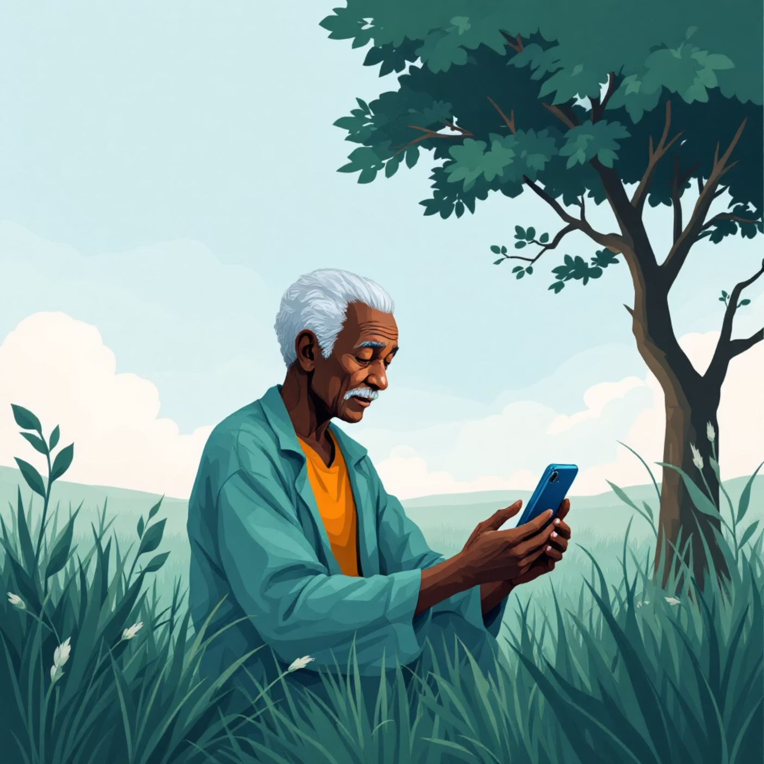
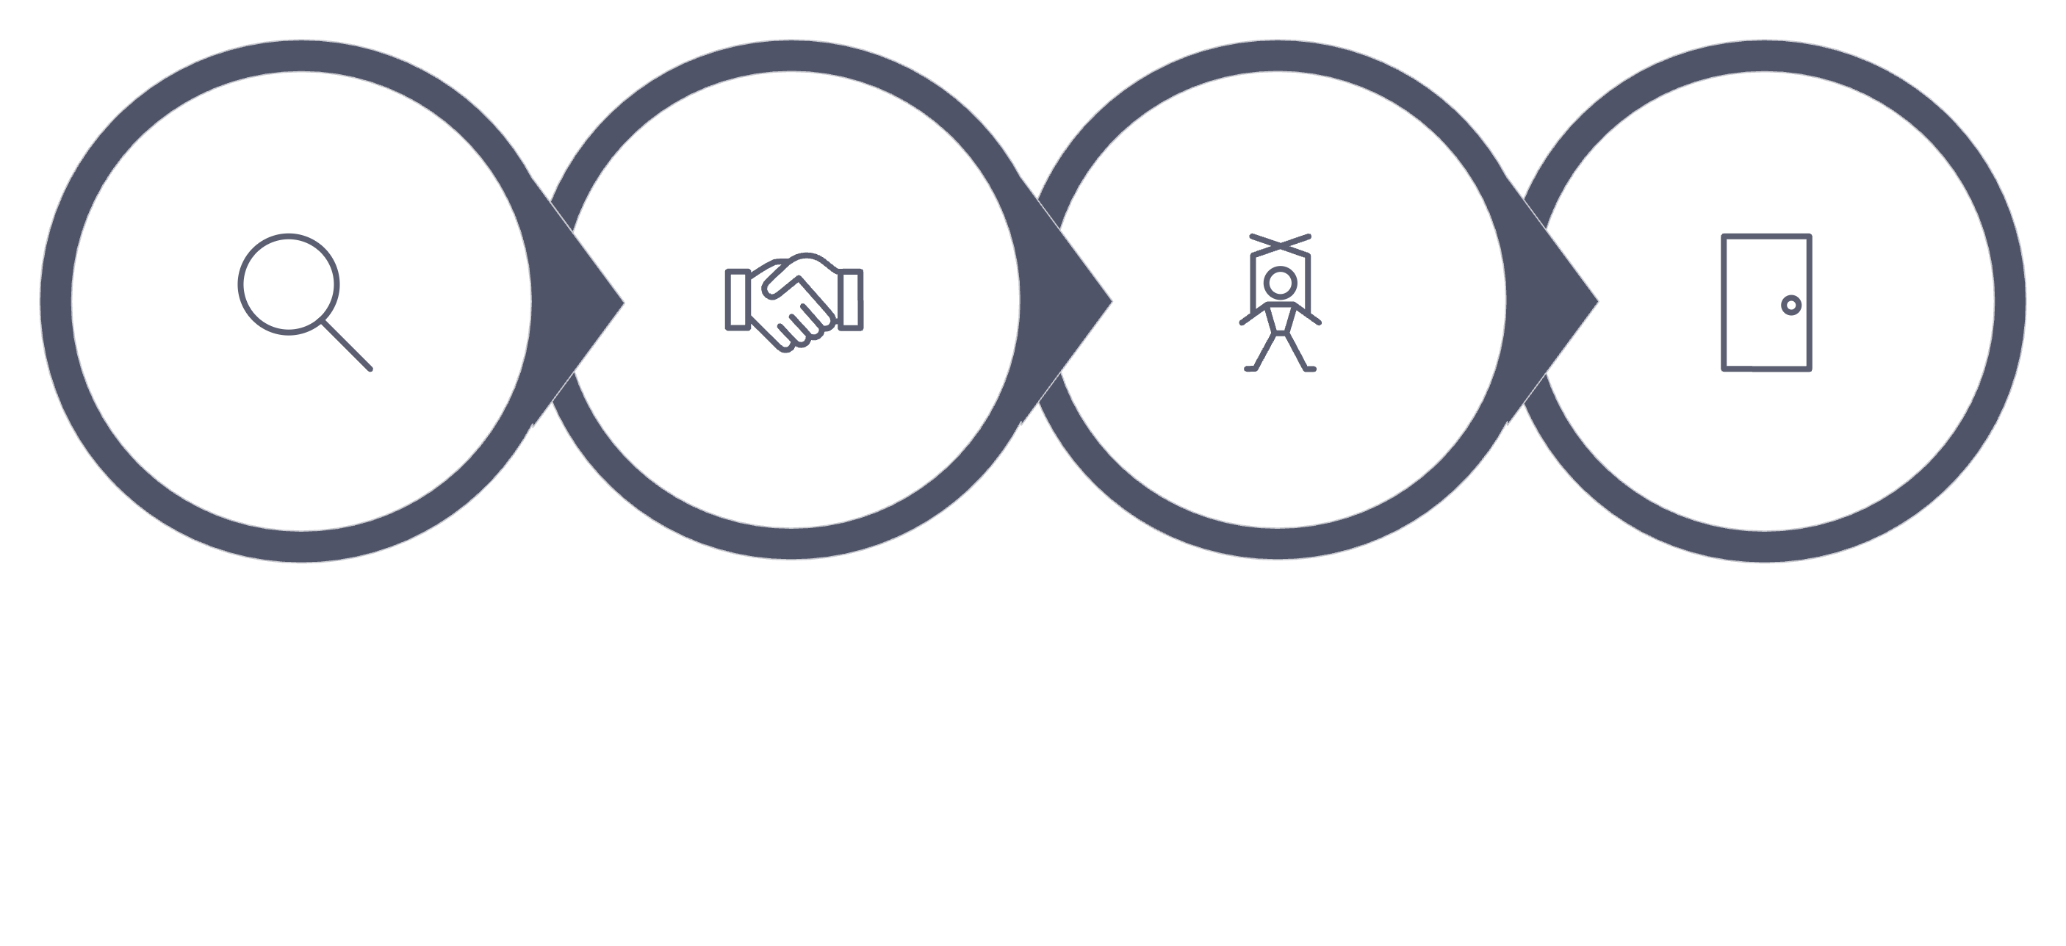

The Challenge: Social Engineering & Vulnerability
Let us define the enemy. In Computer Science, we often focus on hackers breaking into firewalls. But in rural Kenya, the 'hack' is not on the software; it is on the human mind. This is called Social Engineering.
Social engineering is the art of manipulating people into giving up confidential information. The criminals, often operating from prison cells or hidden syndicates (the 'Kamiti' style scams), do not need to know code. They only need to know human psychology.
They exploit two things: Trust and Fear. They create Urgency: 'Your account will be closed in 10 minutes!' They create Authority: 'This is Safaricom Customer Care.'
Information
Build Trust
Manipulation
Exit

Slide 4
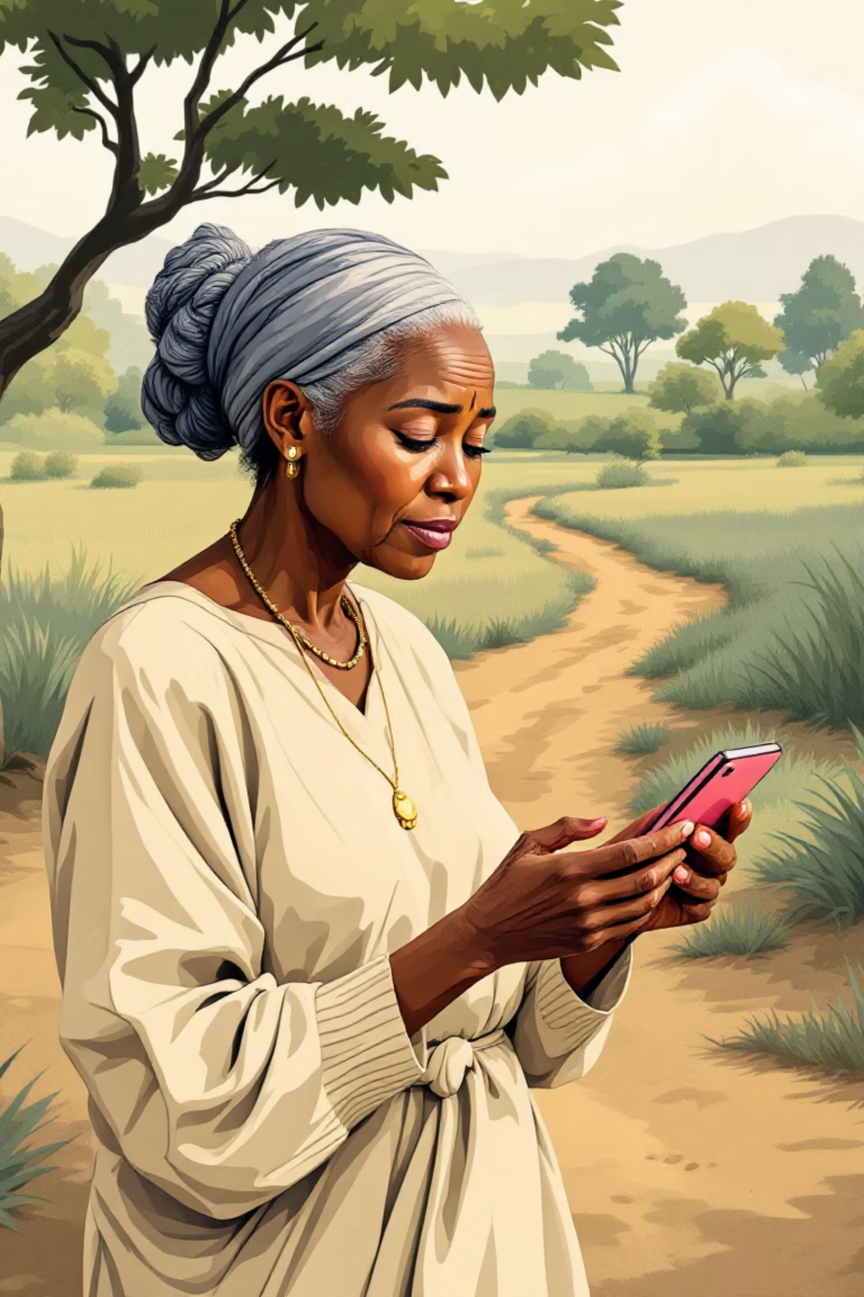


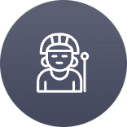
Why the Elderly are Targeted
Digital Divide
Physical Limitations
Elders adopted technology late. They understand the function of M-Pesa (sending money), but often not the security mechanics (PINs, authentication).
Failing eyesight makes it hard to distinguish a legitimate SMS from a fake one, increasing vulnerability to phishing attempts.
Cultural Respect
In many African cultures, including Kikuyu, it is rude to hang up on someone speaking with authority. Scammers weaponize this ingrained respect.

Slide 5
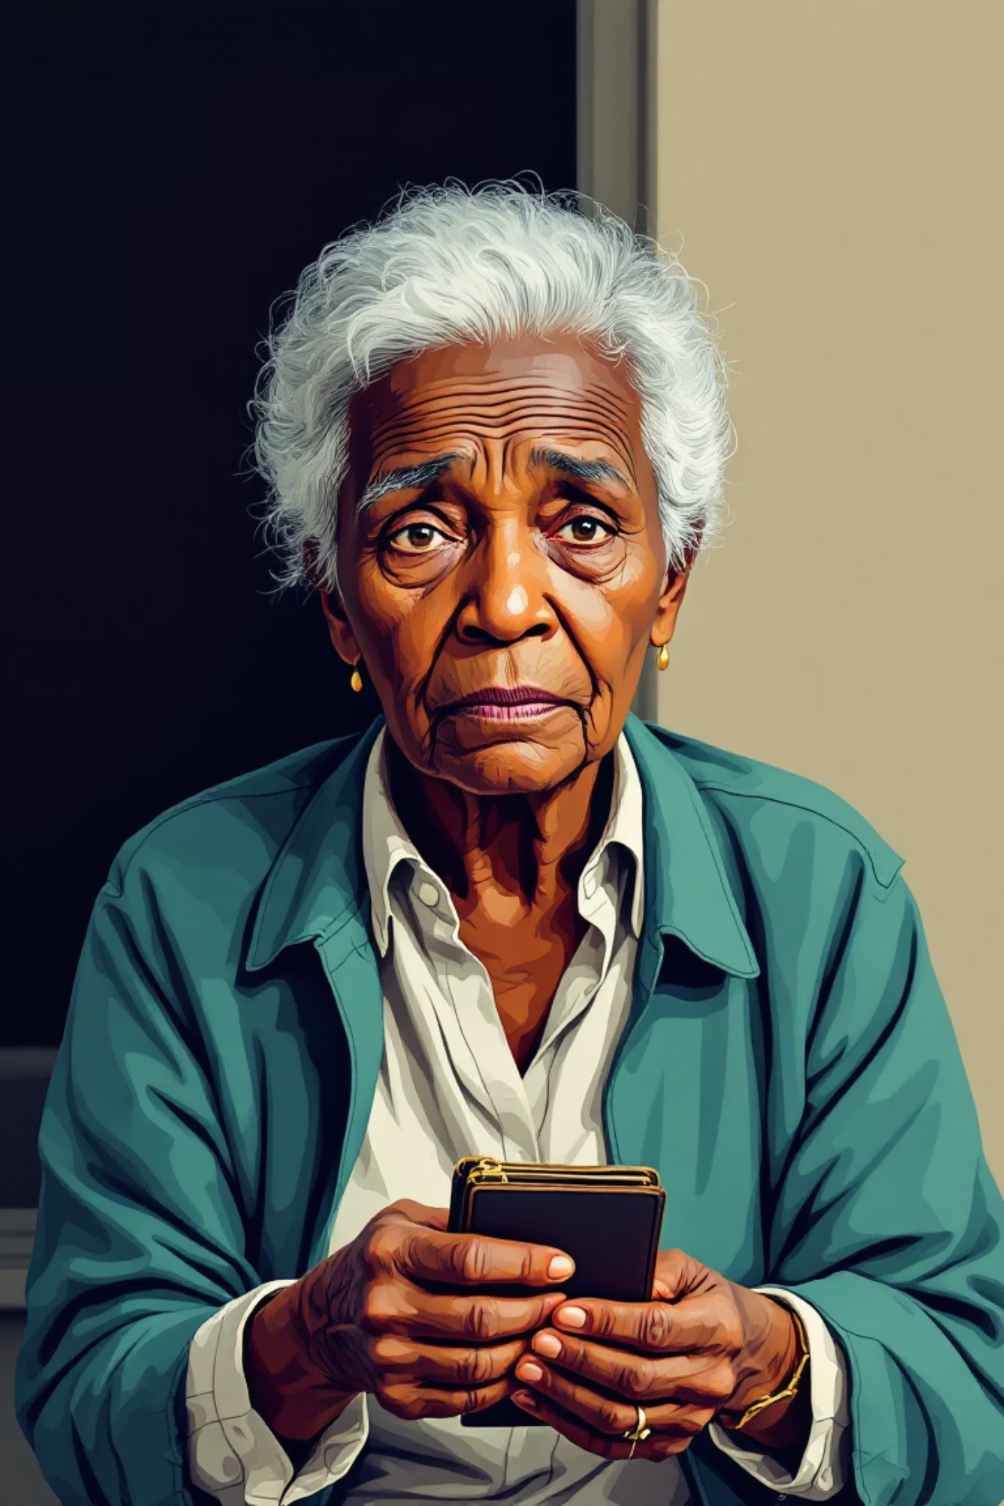
The Devastating Impact
The impact of these scams is devastating, extending far beyond mere financial loss. While a sum like Shilling 5,000 might seem insignificant to a large corporation, to a grandmother in Kiambu, it represents a month's worth of food and essential supplies.
Beyond the monetary aspect, the emotional and social repercussions are profound:
Shame:
Family Conflict:
Severe Stress:
The loss of these vital funds leads to immediate and severe consequences, including:
Inability to purchase food or medicine.
Disruption of household stability.
Increased financial strain on families.

Slide 6
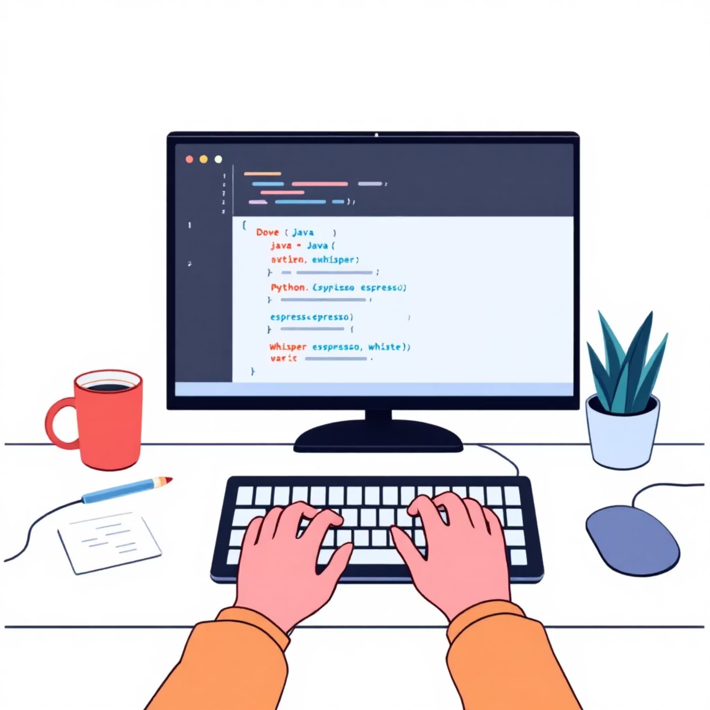
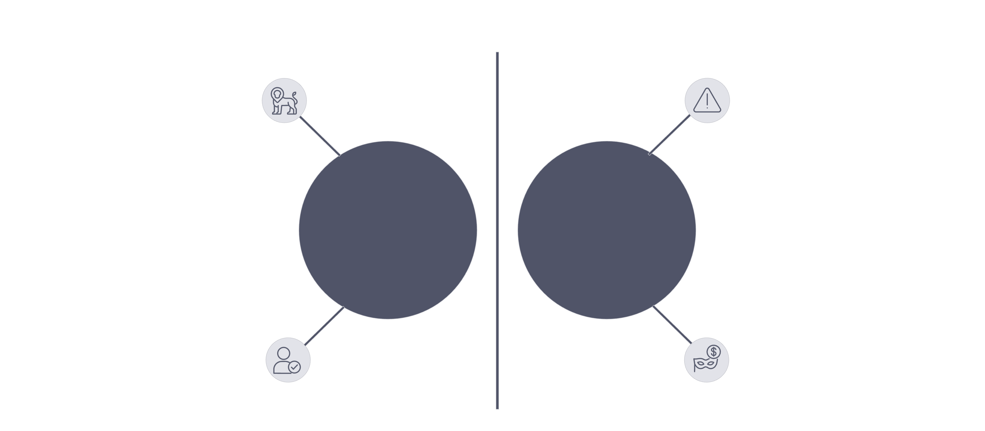
The Technical Solution: AI & Biometrics
As a Computer Science student interested in security, I believe we can code a safety net. My proposed technical solution involves Artificial Intelligence (AI).
Currently, mobile money systems are reactive. You report fraud after it happens. We need a system that is proactive. I propose implementing Anomaly Detection Algorithms using Machine Learning.
How does this work? The system learns the 'normal' behavior of Cucu Wanjiku.
Normal: She sends Ksh 500 to her grandson on Fridays. She buys airtime of Ksh 50.
Abnormal: Suddenly, at 3:00 AM, she is trying to transfer Ksh 20,000 to a new number she has never interacted with.
Consistent transaction rate
Sudden surge in volume
Normal Pattern
Anomaly Spike
Predictable user behavior
Suspicious rapid transfers

Slide 7


AI-Driven Anomaly Detection
01
Learning Normal Behavior
The AI system continuously analyzes transaction patterns to establish a baseline of typical user activity for each individual.
02
Flagging Anomalies
Any transaction that deviates significantly from the learned normal pattern is automatically flagged as suspicious.
03
Cooling Off Period
Instead of immediate processing, flagged transactions trigger a 'Cooling Off' period, allowing time for review and verification.
04
Secondary Approval
For high-risk transactions, the system can require secondary approval from a nominated guardian, such as a trusted family member.

Slide 8
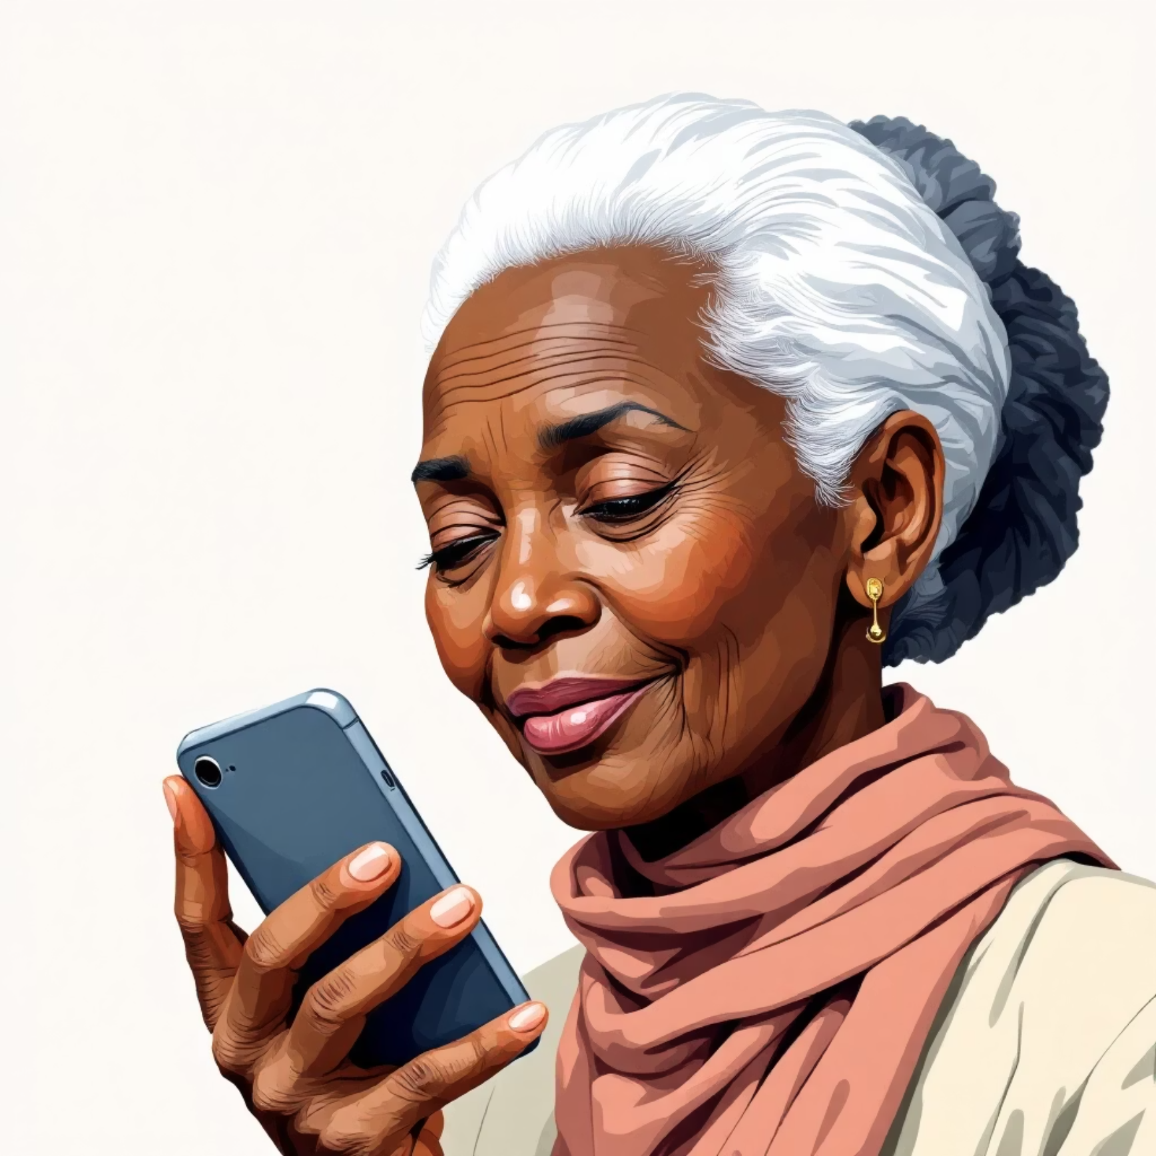
Enhancing Security with Voice Biometrics
Secondly, let’s talk about Biometrics. We force elderly people to remember 4-digit PINs. They often write these PINs on the back of their ID cards because they forget them. This destroys security.
My proposal is Voice Verification. A grandmother may forget a number, but she never forgets her voice. Using Voice Biometrics, the transaction would require her to say a specific phrase. If the voice doesn't match the profile, the transaction is blocked. This eliminates the threat of someone stealing her PIN.
PINs are Vulnerable
Voice is Unique
Enhanced Security
Easy to forget, often written down, making them susceptible to theft and misuse.
Each person's voice is distinct, providing a robust and natural form of authentication.
Voice biometrics significantly reduces the risk of unauthorized transactions, even if PINs are compromised.

Slide 9
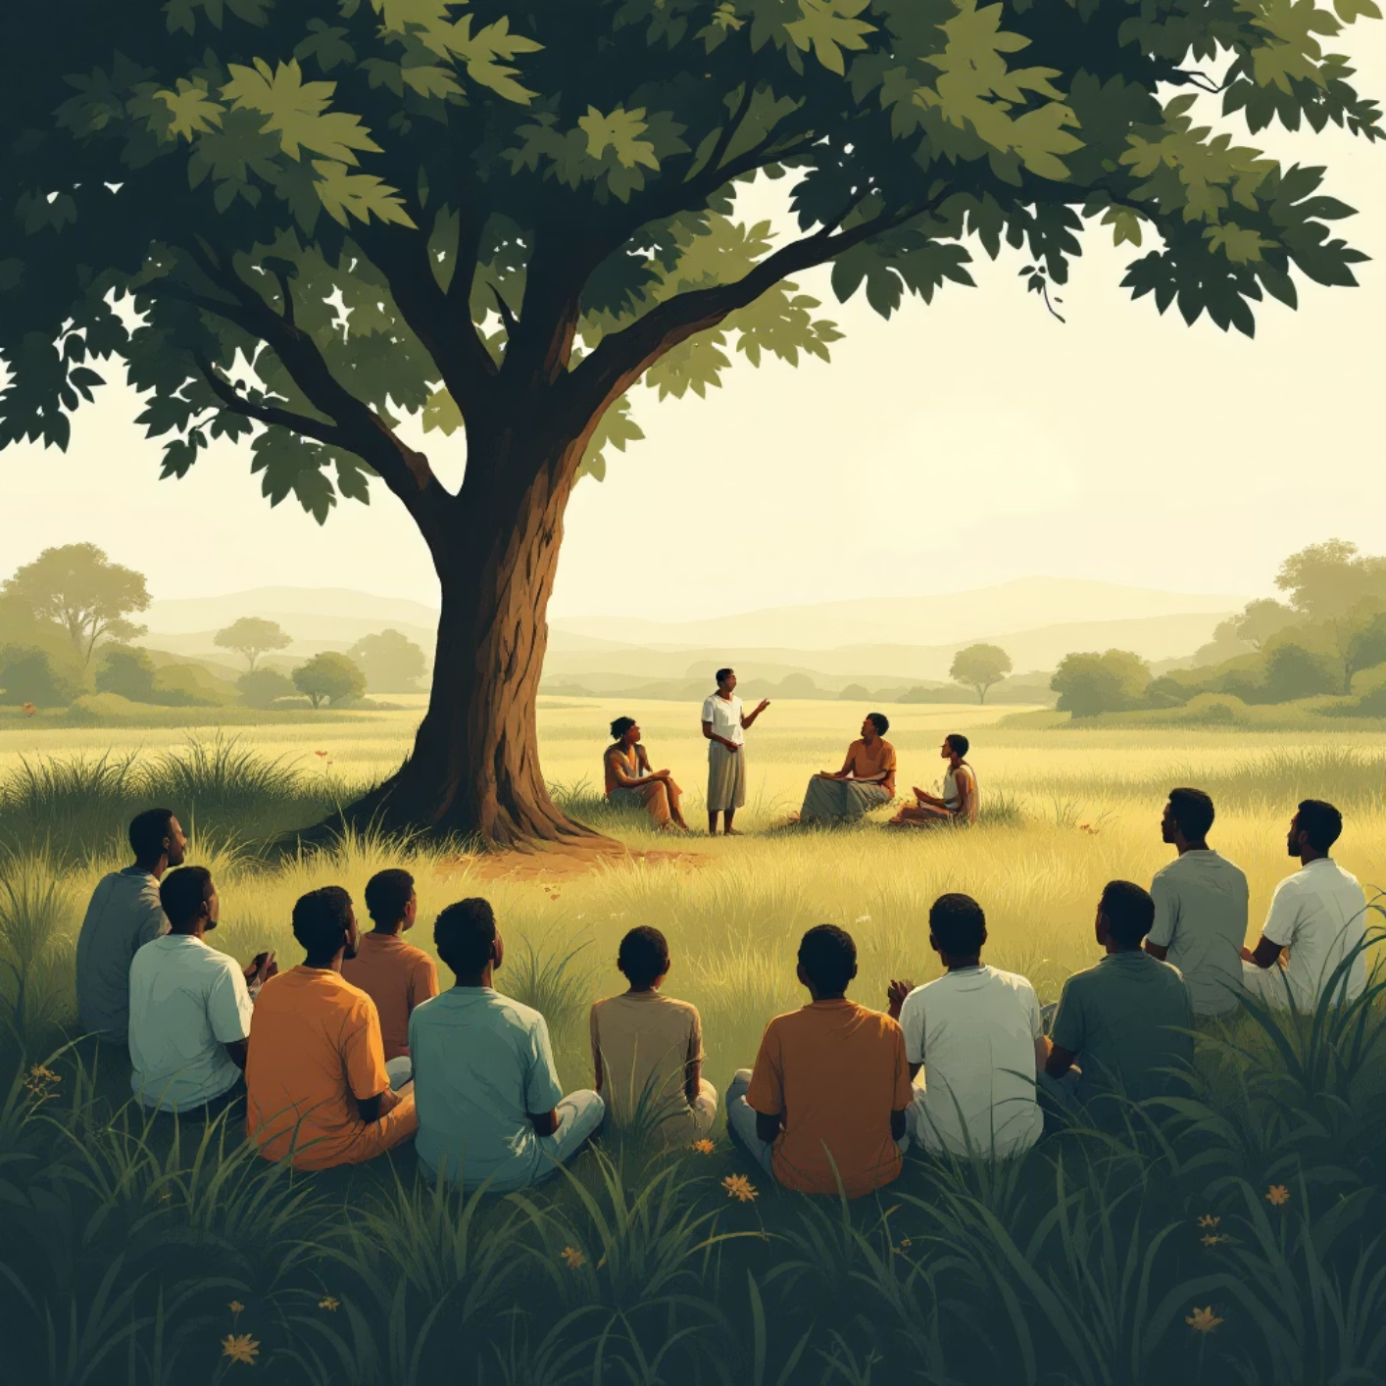



The Social Solution: Digital Barazas
However, code is not enough. You cannot patch a human being with a software update. We need education.
I propose a community initiative called 'The Digital Baraza.' In our society, the 'Baraza' is where information is shared. We need to bring cybersecurity to the village level, but it must be done correctly.
Sending a tech expert from Nairobi to speak English to elders in Kiambu will fail. The training must be in Indigenous Languages (Kikuyu, in my region). We must translate concepts like 'Phishing' into stories and proverbs they understand.
I also propose a Youth Mentorship Model. We have thousands of university students, like myself, returning home for holidays. We should launch a structured volunteer program where we spend time teaching our own grandparents 'Cyber Hygiene.'
Don't share your PIN.
Safaricom will never ask for your PIN.
If you are scared, hang up and call your son/daughter.
This bridges the gap between the generation that built the country and the generation that is building the future.
Facilitation
Awareness
Community-led teaching session
Recognize common digital risks
Practical Skills
Support
Hands-on device practice
Ongoing local help networks

Slide 10
Conclusion: Inclusive Security
To conclude, the rise of mobile money in Kenya is a success story, but we cannot let our most vulnerable citizens become the victims of that success.
The challenge of cybersecurity for the elderly is real. It destroys wealth and it destroys dignity. My solution is two-fold:
Technical Solution
Social Solution
Implementing AI for anomaly detection and Voice Biometrics to replace PINs.
Launching Digital Barazas to educate through culture and language, supported by a youth mentorship model.
As I prepare to graduate and enter the tech industry, my pledge is to build systems that are not just smart, but inclusive. Security should not be a luxury for the young and tech-savvy. It must be a right for everyone, including Cucu Wanjiku in the village.
Technology must serve humanity, not exploit it. Thank you. Asanteni. Ni thewa.

